Slide 1



Data Preparation and Weight Initialization
Indian Institute of Information Technology, Allahabad
By
Dr. Shiv Ram Dubey Assistant Professor Computer Vision And Biometrics Lab (CVBL) Department Of Information Technology Indian Institute Of Information Technology, Allahabad
Email: srdubey@iiita.ac.in Web: https://profile.iiita.ac.in/srdubey/

Slide 2
Disclaimer
The content (text, image, and graphics) used in this slide are adopted from many sources for academic purposes. Broadly, the sources have been given due credit appropriately. However, there is a chance of missing out some original primary sources. The authors of this material do not claim any copyright of such material.

Slide 3
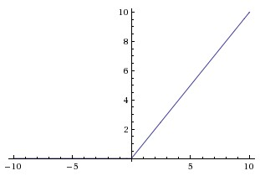
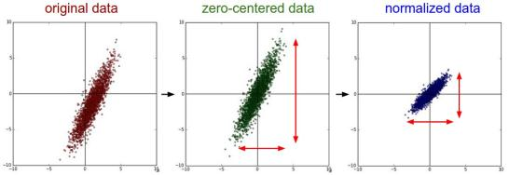
This Class
Data and Weight Setup
Dataset Preparation
Data Preprocessing
Weight Initialization

Slide 4
Dataset Preparation Train/Val/Test sets

Slide 5
In General People Do: Train/Test
Split data into train and test,
Choose hyperparameters that work best on test data

Slide 6
In General People Do: Train/Test
Split data into train and test,
Choose hyperparameters that work best on test data
BAD: No idea how algorithm will perform on new data

Slide 7
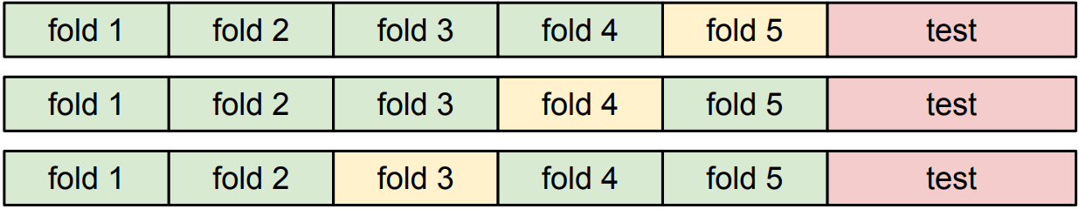
K-Fold Validation
Split data into folds,
Try each fold as validation and average the results

Slide 8
K-Fold Validation
Split data into folds,
Try each fold as validation and average the results
Useful for small datasets, but not used too frequently in deep learning

Slide 9
Better Approach: Train/Val/Test sets
Split data into train, val, and test;
Choose hyperparameters on val and evaluate on test

Slide 10
Better Approach: Train/Val/Test sets
Split data into train, val, and test;
Choose hyperparameters on val and evaluate on test
Division can be done based on the size of dataset:
Roughly 10k or 10% whichever is less for val and test sets.
Rest in train set.

Slide 11
Data Preprocessing

Slide 12
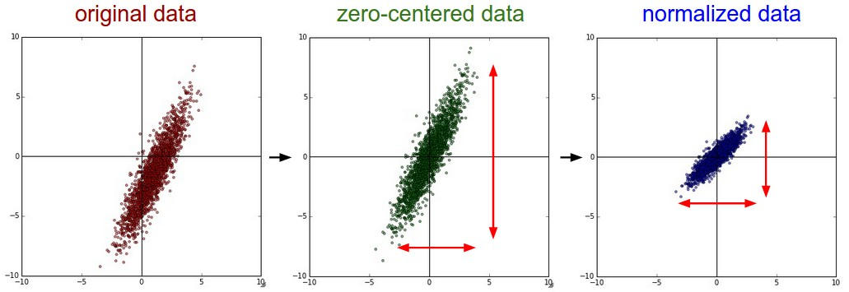
Data Preprocessing
Source: cs231n

Slide 13
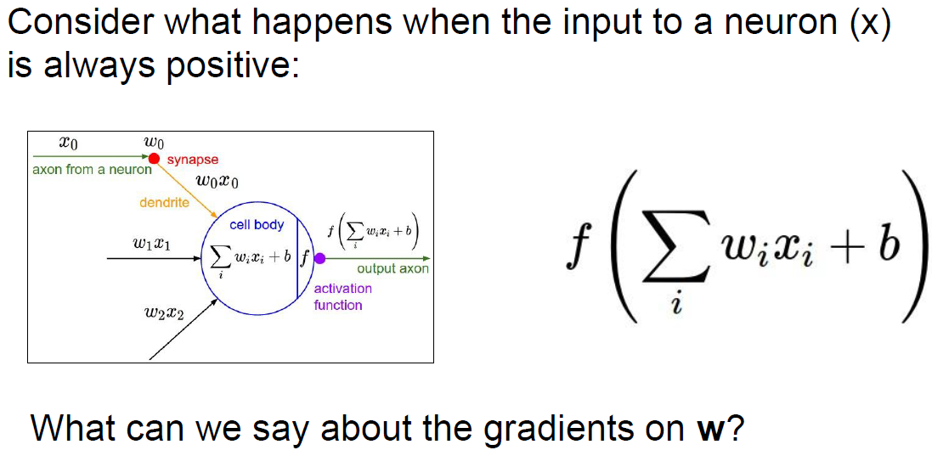
Data Preprocessing
Always all positive or all negative
(this is also why you want zero-mean data!)
Source: cs231n, Stanford University

Slide 14
Data Preprocessing
In practice for Images: only centering is preferred
e.g. consider CIFAR-10 example with [32,32,3] images
Subtract the mean image (e.g. AlexNet)
(mean image = [32,32,3] array)
Subtract per-channel mean (e.g. VGGNet, ResNet, etc.)
(mean along each channel = 3 numbers)
Source: cs231n

Slide 15
Weight Initialization

Slide 16
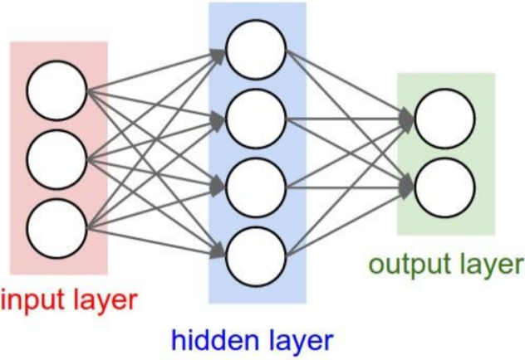
Weight Initialization: Constant
Q: what happens when W=Constant init is used?

Slide 17
Weight Initialization: Constant
Q: what happens when W=Constant init is used?
Every neuron will compute the same output and undergo the exact same parameter updates.
There is no source of asymmetry between neurons if their weights are initialized to be the same.
Source: cs231n

Slide 18
Weight Initialization: Gaussian
First idea: Small random numbers
(Gaussian with zero mean and 1e-2 standard deviation)
Symmetry breaking: Weights are different for different neurons
Source: cs231n

Slide 19
Weight Initialization: Gaussian
First idea: Small random numbers
(Gaussian with zero mean and 1e-2 standard deviation)
Symmetry breaking: Weights are different for different neurons
Works ~okay for small networks, but problems with deeper networks,
i.e. Almost all neurons will become zero
-> gradient diminishing problem.
Source: cs231n

Slide 20
Weight Initialization: Gaussian
First idea: Small random numbers
(Gaussian with zero mean and 1e-2 standard deviation)
Symmetry breaking: Weights are different for different neurons
Works ~okay for small networks, but problems with deeper networks,
i.e. Almost all neurons will become zero
-> gradient diminishing problem.
Increase the standard deviation to 1
Source: cs231n

Slide 21
Weight Initialization: Gaussian
First idea: Small random numbers
(Gaussian with zero mean and 1e-2 standard deviation)
Symmetry breaking: Weights are different for different neurons
Works ~okay for small networks, but problems with deeper networks,
i.e. Almost all neurons will become zero
-> gradient diminishing problem.
Increase the standard deviation to 1
Almost all neurons completely saturated, either -1 or 1. Gradients will be all zero.
-> gradient diminishing problem.
Source: cs231n

Slide 22
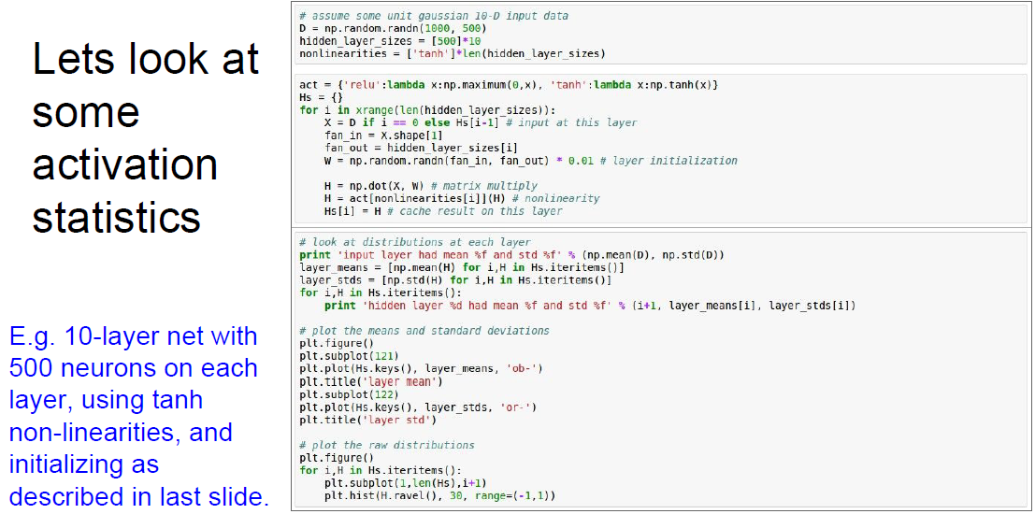
Weight Initialization: Gaussian
Source: cs231n

Slide 23
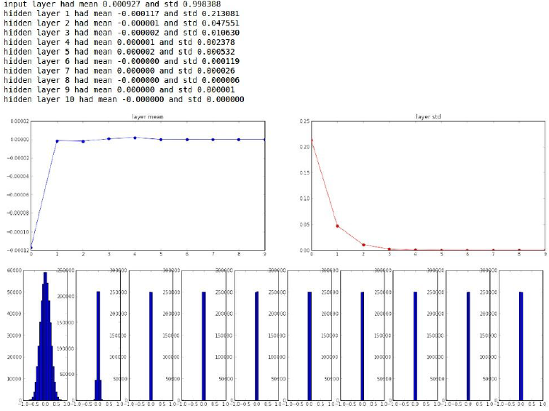
Weight Initialization: Gaussian
Source: cs231n

Slide 24
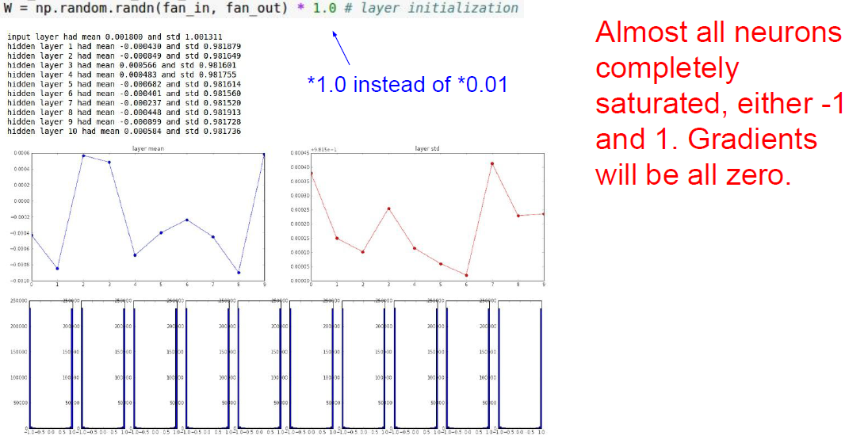
Weight Initialization: Gaussian
Source: cs231n

Slide 25
Weight Initialization: Xavier
[Glorot et al., 2010]
Calibrating the variances with 1/sqrt(fan_in)
$$W={np.random.randn\left(fan_in, fan_out\right)}/{np.}sqrt(fan_in)$$
Reasonable initialization.
(Mathematical derivation assumes linear activations)
Source: cs231n

Slide 26
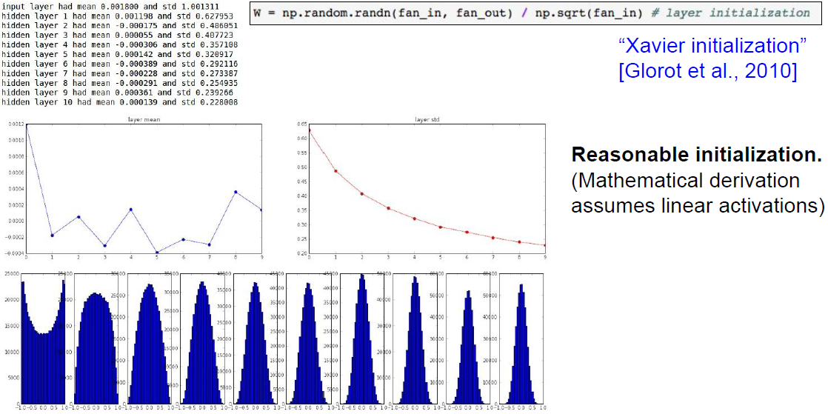
Weight Initialization: Xavier
Source: cs231n

Slide 27
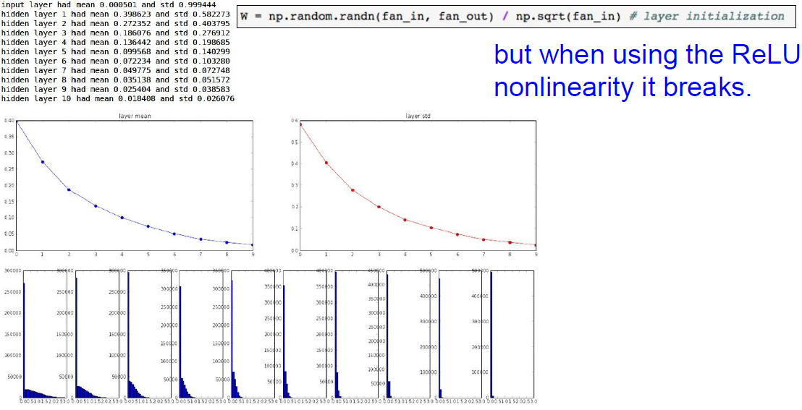
Weight Initialization: Xavier
Source: cs231n

Slide 28
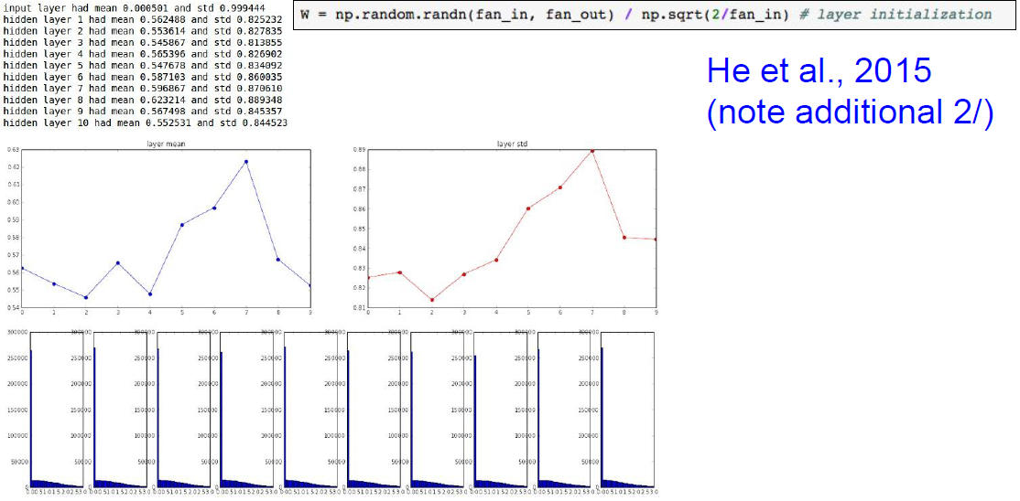
Weight Initialization: XavierImproved
Source: cs231n

Slide 29
Weight Initialization: XavierImproved
×
Source: cs231n

Slide 30
Proper initialization is an active area of research…
Understanding the difficulty of training deep feedforward neural networks by Glorot and Bengio, 2010
Exact solutions to the nonlinear dynamics of learning in deep linear neural networks by Saxe et al, 2013
Random walk initialization for training very deep feedforward networks by Sussillo and Abbott, 2014
Delving deep into rectifiers: Surpassing human-level performance on ImageNet classification by He et al., 2015
Data-dependent Initializations of Convolutional Neural Networks by Krähenbühl et al., 2015
All you need is a good init by Mishkin and Matas, 2015
…
Source: cs231n

Slide 31
Acknowledgement
Thanks to the following courses and corresponding researchers for making their teaching/research material online
Deep Learning, Stanford University
Introduction to Deep Learning, University of Illinois at Urbana-Champaign
Introduction to Deep Learning, Carnegie Mellon University
Convolutional Neural Networks for Visual Recognition, Stanford University
Natural Language Processing with Deep Learning, Stanford University
And Many More ......

